Slide 1
Strike Force Battalion
Continuous Improvement Briefing
Haralson County High School
Army JROTC
School Year: 2018-2019
SAI: LTC Anthony J. Hardy
AI: 1SG Andrew W. Brown Ⅲ

Slide 2
Agenda
JROTC Program Accreditation (JPA)
March 19, 2019
Meet and Greet with Administration Staff
Movement to JROTC Building
Movement to Auxiliary Gym (Select personnel)
In-Rank Inspection (Auxiliary Gym)
Service Learning Briefing (Cadet Staff)
Community Service Project (Cadet Kaitlyn Crews)
Notes:
Csm Driskell

Slide 3
Agenda
JROTC Program Accreditation (JPA)
March 19, 2019
Color Guard Presentation (Auxiliary Gym)
Instructor Portfolio Interview
Lunch JROTC Area
Cadets Portfolio Interview
Continuous Improvement Briefing (Cadet Staff)
Brigade out Briefing/ Results

Slide 4
HCHS Strike Force Battalion
Special Presentation
The Pledge of Allegiance:
Cadet SFC Kaitlyn Crews
The JROTC Cadet Creed:
Cadet 2 LT Aaron Porter
Notes:
Csm Driskell

Slide 5
Goal of the Strike Force Battalion:
Create an environment that is conducive to learning. Assist cadets to become better citizens through the use of curriculum manager led teaching strategies. These strategies, simply stated, make learning fun. Cadets learn from each other by becoming active stakeholders/participants. Importance is placed on accountability for one’s actions.
Notes:
CSM Driskell

Slide 6
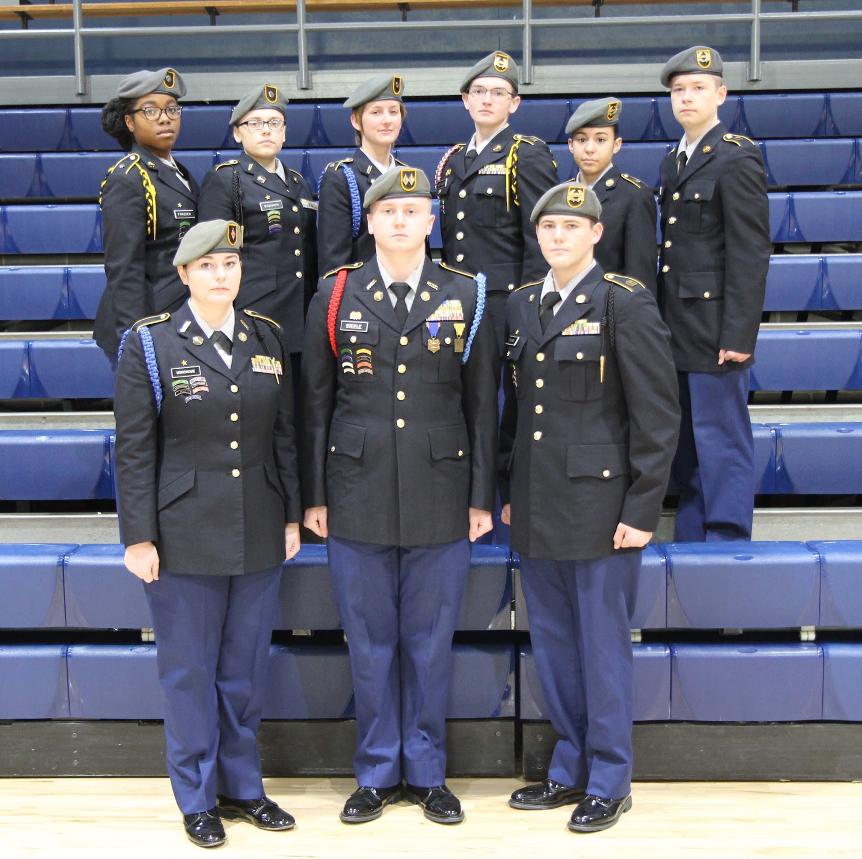
Strike Force Battalion Cadet Staff:
Battalion Commander (BC): Cadet Lieutenant Colonel Preston Steele
Executive Officer (XO): Cadet Major Elizabeth Haney
S-1 (Administrative Officer): Cadet 2LT Ayshanna Frazier
S-2 (Security Officer): Cadet 2LT Victoria Bowman
S-3 (Operations Officer): Cadet 2LT Isabell Byrd
S-4 (Supply Officer): Cadet MSG Brandon Alexander
S-5 (Public Affairs Officer): Cadet MSG Emilie Lopez
Sergeant Major (SGM): Cadet Sergeant Major Ethan Driskell
Notes:
Csm Driskell

Slide 7
Strike Force Battalion Cadet Staff:
Cadet Sergeant Major Ethan Driskell
BN Com.
Cadet Lieutenant Colonel Preston Steele
Cadet 2LT Ayshanna Frazier
BN
SGM
S-1
A
Com.
Cadet 1LT Victoria Parrish
Cadet 2LT Shyanne Bowman
A
Com.
1SG
Cadet 1SG Colby Cheveres
S-2
B
Com.
1SG
Cadet 1SG Savannah Hill
B
Com.
Cadet 2LT Aaron Porter
BN
XO
Cadet 2LT Isabell Byrd
Cadet Major Elizabeth Haney
S-3
C
Com.
Cadet CPT Gracee Keaton
Cadet MSG Brandon Alexander
C
Com.
1SG
Cadet 1SG Austin Helton
S-4
D
Com.
1SG
Cadet 1SG Colton Sensing
D
Com.
Cadet CPT Ashley Edwards
S-5
Cadet MSG Emilie Lopez
Notes:
Csm Driskell

Slide 8
Areas For Improvement
● Drill Team
○ Practice at 4:15 - 5:30 Wednesday & Friday
○ Began with 18
○ Ended with 6
● Marksmanship Team
○ Practice 4:15-5:30 Tuesday & Thursday
○ Began with 12
○ Ended with 5
Notes:
Csm Driskell

Slide 9
Battalion Commander:
Cadet Lieutenant Colonel Preston Steele
Topics for discussion:
Continuous Improvement plan
Role in the Strike Force Battalion
Strike Force Battalion History
Goals /Purpose/ Opportunity as the Battalion Commander
Georgia Graduate
JROTC Impact on Daily Life
Notes:
Commander

Slide 10
Battalion Commander
Role in Strike Force Battalion:
Lead by Example, Be, Know and Do ● Ensure that Battalion Knows and Displays Proper Military Customs and Courtesies ● Ensure Compliance with Governing Directives and Policies ● Ensure all Company Commanders Fully Understand Their Expectations ● Ensure the Battalion Operates Smoothly and Effectively ● Leads the Battalion Based on Guidance From the SAI and AI ● Serve as Resident Expert on Drill and Ceremony
Notes:
Commander Steele

Slide 11
Role in Continuous Improvement Brief/Plan:
● Delegate Tasks to Ensure Presentation is Accurate
● Oversee/Assist in all Projects Related to JPA
● Show Cadets the value of the JROTC Program
● Build Relationships/Promote JROTC Program
● Ensure that those in Leadership Positions Have the Same Mindset
● Be an example of how participation = more responsibility in a positive manner
Battalion Commander
Notes:
Commander Steele

Slide 12
Strike Force Battalion
History
The Haralson County High School Army Junior Reserve Officer Training Corps Battalion was established on June 1, 2005, with an effective date of August 4, 2005.
The program was initially housed in the main campus, room 176, until it was relocated in the old Field House in March 2006.
In July 2006, the battalion received full certification after its’ initial evaluation conducted by 6th Brigade, Eastern Region, U.S. Army Cadet Command.
The evaluation and full certification resulted in the battalion being ranked in the top 5% in the state of Georgia.
Notes:
Commander Steele

Slide 13
Strike Force Battalion
History
Produced Two Commissioned Officers
1- Jacksonville State University
1- Georgia Tech University
25 Enlisted into U.S. Army
6 Enlisted into U.S. Marine Corps
10 Enlisted into U.S. Navy
12 Enlisted into U.S. Army National Guard
18 Enlisted into U.S. Army Reserves
Honor Unit with Distinction since 2009 to present
Notes:
Commander Steele

Slide 14
PURPOSE
Each One Teach One: A critical issue in our JROTC Program is a lack of participation. One of our primary goals is to improve this shortcoming.
The HCHS Strike Force Battalion participates in a number of events for the community and HCHS. In the past year, we conducted a Veterans’ Day Salute and a 9 11 Memorial Service honoring those who faithfully served our country.
Additionally, some of our cadets volunteered at local elementary/middle schools providing service learning opportunities i.e. Career Day, leading the Pledge of Allegiance, serving breakfast to local veterans, and lending a helping hand to those in need at the Tallapoosa’s Food Bank.
Notes:
Commander Steele

Slide 15
Purpose of the Strike Force Battalion
Opportunity
Each One Teach One: A critical issue in our JROTC Program is lack of participation.
One of our primary goals is to improve the enrollment of students in this area.
The Strike Force Battalion participates in a number of community/school events.
In the past year:
Veterans Day Salute
9/11 Memorial Service
Career Day / Sport Activities
Leading the Pledge
Breakfast for Veterans
Volunteering at Tallapoosa’s Food Bank
Notes:
OPPORTUNITY:
Each One Teach One: A critical issue in our JROTC Program is a lack of participation. One of our primary goals is to improve this shortcoming.
The HCHS Strike Force Battalion participates in a number of events for the community and HCHS. In the past year, we conducted a Veterans’ Day Salute and a 9 11 Memorial Service honoring those who faithfully served our country. Additionally, some of our cadets volunteered at local elementary/middle schools providing service learning opportunities i.e. Career Day, leading the Pledge of Allegiance, serving breakfast to local veterans, and lending a helping hand to those in need at the Tallapoosa’s Food Bank.

Slide 16
HCHS Battalion Goal PROFILE OF THE
Georgia Graduate

Slide 17
Battalion Commander JROTC In My Life
Class: U3-C10-L2 Goals and Goal Setting ● Impact on me as I look forward in my life ○ Priorities ○ Organized ○ Plan ● Personal Story

Slide 18
Executive Officer Cadet Major Elizabeth Haney
Topics of Discussion:
Role in Continuous Brief/Plan
Lesson to Achieve Goal
Staff Involvement
Fundraisers
Discipline and Character Development
JROTC Teams
Primary Duties/Responsibilities
JROTC Impact In My Life

Slide 19
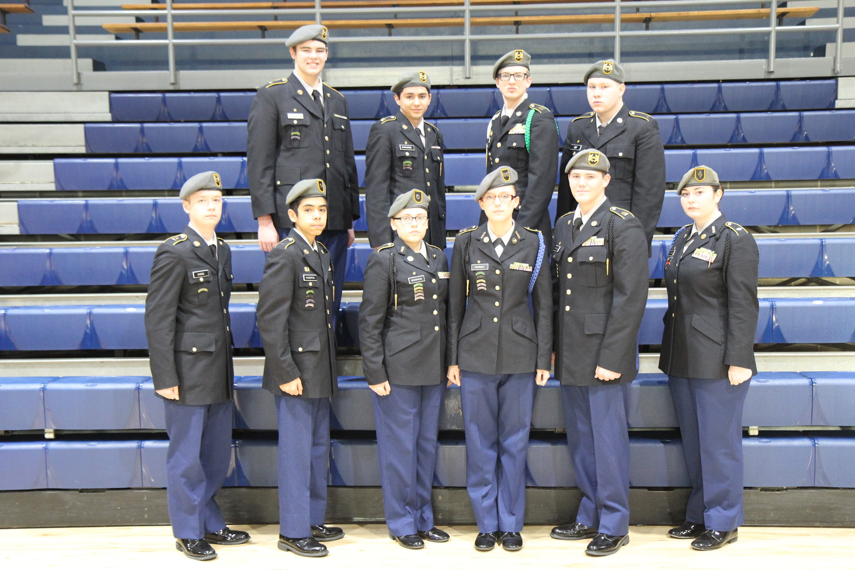
Executive Officer Cadet Major Elizabeth Haney
Strike Force Battalion
Alpha Company Motto
Alpha is the Best, We’re Above the Rest
Notes:
link

Slide 20
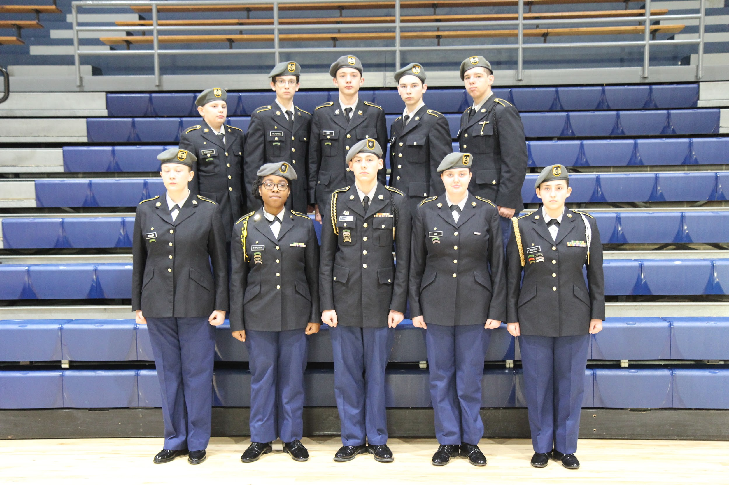
Executive Officer Cadet Major Elizabeth Haney
Strike Force Battalion
Bravo Company Motto
Bravo, The Force is Strong, Come And Get Some!
Notes:
link

Slide 21
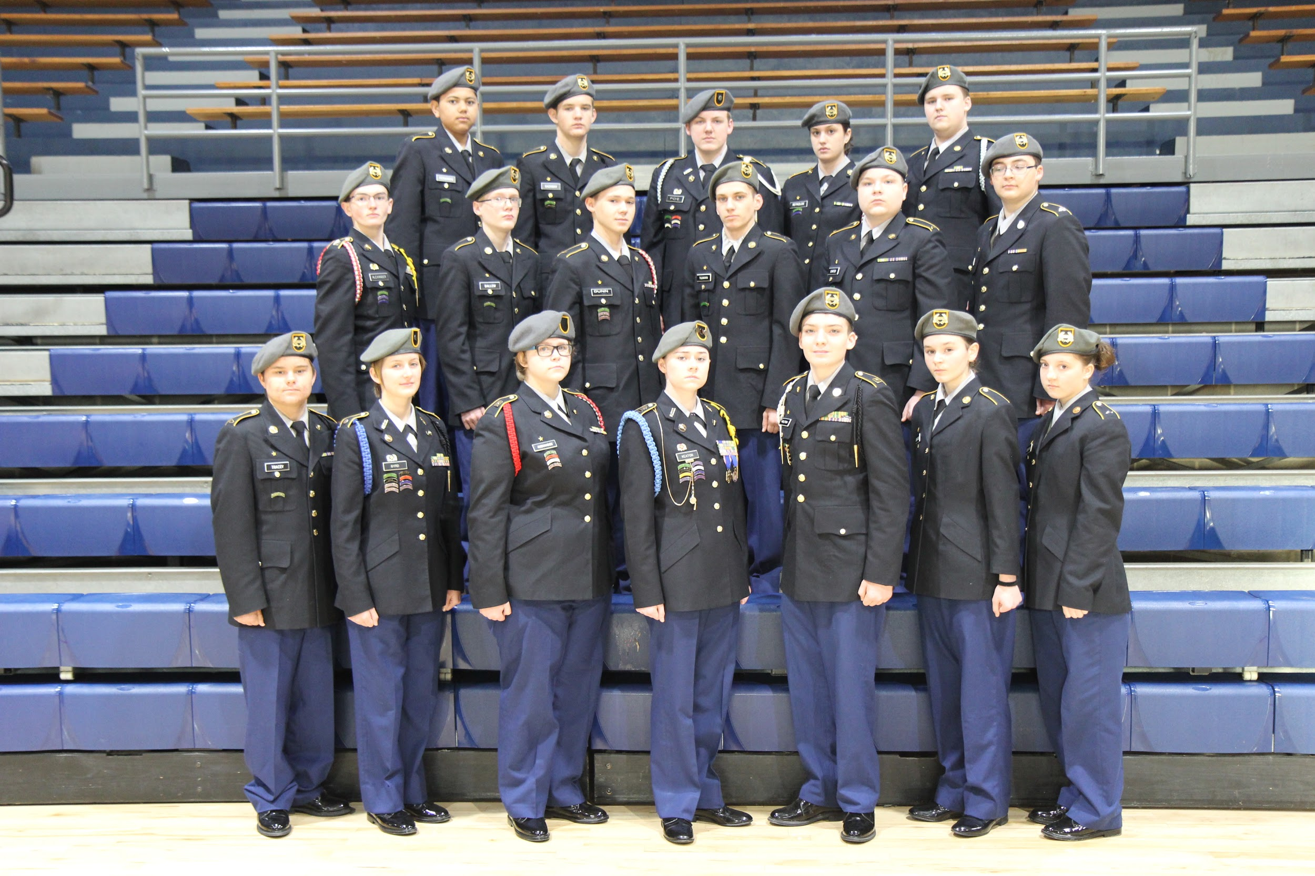
Executive Officer Cadet Major Elizabeth Haney
Strike Force Battalion
Charlie Company Motto
Motivate, Motivate, Charlie Will Dominate!

Slide 22
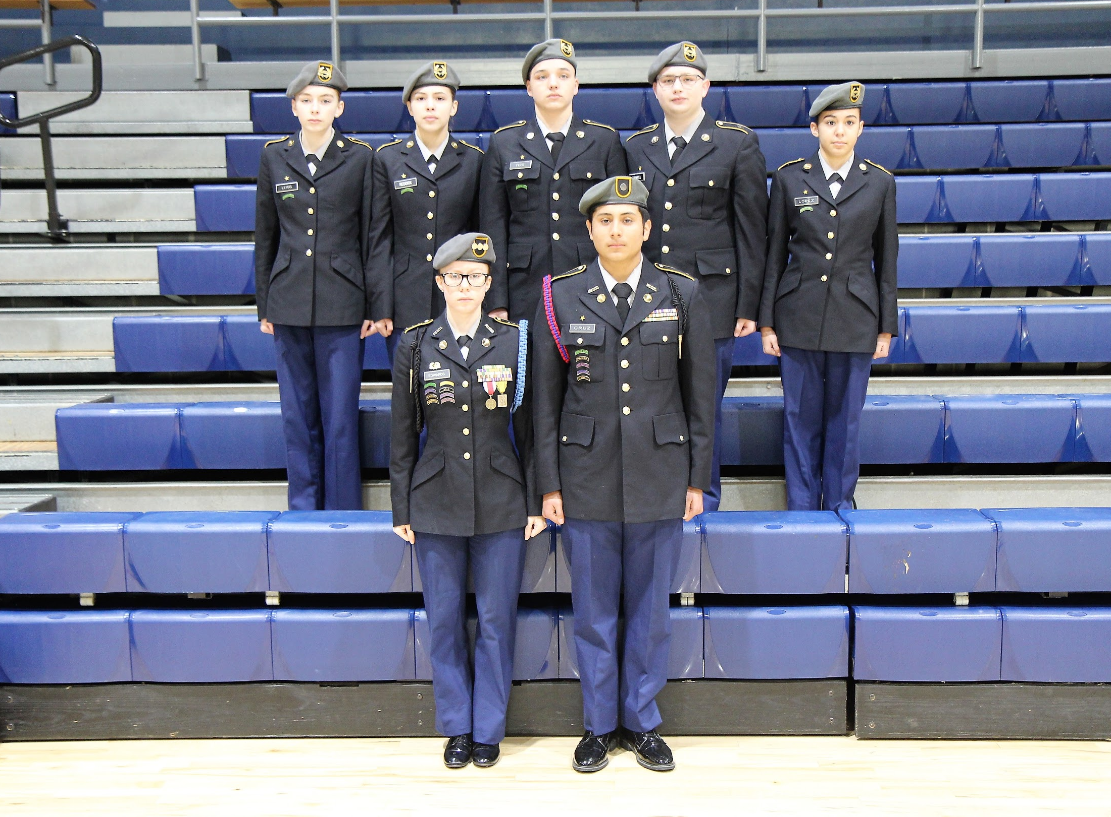
Executive Officer Cadet Major Elizabeth Haney
Strike Force Battalion
Delta Company Motto
Delta Force Leaders of Today And Tomorrow!
Notes:
link

Slide 23
Executive Officer Cadet Major Elizabeth Haney
Primary Duties in Strike Force Battalion:
● Ensure That Staff is Properly Trained
Ensure That Staff Performs Their Duties
Delegate additional duties per the Battalion Commander, SAI {Senior Army Instructor}, AI {Army Instructor}.
Advise Battalion Commander on Disciplinary Issues Within the Battalion
Conduct Periodic Inspections of The Arms & Supply Rooms Respectively
Notes:
Format text

Slide 24
Executive Officer Cadet Major Elizabeth Haney
Role in Continuous Improvement Plan:
● Be a positive role model for cadets and motivate them to participate in JROTC events ● Lead by example and train cadets on Color Guard and UnArmed Platoon events, so they will feel comfortable when participating. ● Explain to cadets the benefits of participating in JROTC events and how it can assist them get promotions or awards.
Notes:
The second bullet is something that falls under the purvue of the SGM

Slide 25
Executive Officer Cadet Major Elizabeth Haney
Lessons Used to Help Achieve Goal:
Class: U2-C6-L5 Motivation
U3-C10-L3 Time Management How This Affected Goal:
Encourage Staff to Obtain Their Goals Established by Performance Based Counselings.
Make Corrections as Needed
Always Provide Sound and Timely Words of Encouragement.
Time management, accountability in planning events to
Ensure Accomplishment of All Assigned Tasks.

Slide 26
Executive Officer Cadet Major Elizabeth Haney
Staff Involvement
● Facilitate Staff Concerns ● Military Ball 2019 {Scheduled for 4 May 2019/How much will it cost?} ○ Cost includes a DJ, catering, location, decorations, affiliated costs? ○ Cost of Non JROTC attendees $15.00 per individual, $25.00 per couple. ● Community Involvement/Sponsors?
Fort Benning, GA Field Trip {Scheduled for 26 April 2019}
Picnic {Tanner Park} Date to be Determined

Slide 27
Executive Officer Cadet Major Elizabeth Haney
Main Fundraisers
● Candy Drive ○ Popcorn Drive ● Car Wash Drive
○ America Pizza

Slide 28
Executive Officer
Executive Officer Cadet Major Elizabeth Haney
Discipline:
● Discuss the Importance of Leading by Example and Doing the Right Thing at All Times {Even When There is No One Watching}. This Idea is Known as Integrity.
Character Development: ● Character that is above reproach.
Get to Class on Time.
Be Prepared by Having Chrome Book, Paper, Pencil/Pen etc.
No Fighting, Profanity, Vaping, Kissing, Dress Code Violations etc.
Taking Responsibility For Your Actions.

Slide 29
Executive Officer Cadet Major Elizabeth Haney
JROTC Teams
● Drill Team ○ Five events (Color Guard, Squad w/wo Arms, Platoon w/wo Arms)
○ Color Guard Team ●
Rifle Team ○ Three Positions (Prone, Kneeling, Standing)
Saber Team
Raider Team

Slide 30
Executive Officer Cadet Major Elizabeth Haney
Impact of JROTC on Me:
Class: U2-C4-L4 Decision Making and Problem Solving How It Impacted Me: ● Patience With Others ● Making Better Decisions Based Upon Fact and Not How I May Feel About a Certain Individual{s} ● Being Passionate About What I Say and Do. ● Become a Better Listener
Don’t Rush to Judgement
Be Sure to Look at All Sides of an Issue before taking action.

Slide 31
S-1 Administrative Officer Cadet 2LT Ayshanna Frazier
Primary Duties & Responsibilities
● Maintain & Update Cadet Personnel Records ● Input Cadet Awards/Ribbons/Decorations ● Promotions/Demotions ● Maintain JUMS {Junior ROTC Unit Management System} ● Establish & Maintain Database for Registry

Slide 32
S-1 Administrative Officer
Role in Strike Force Battalion:
Establish and Maintain a Database for Registry
Responsible for the input of cadet awards/ribbons, publish orders into JUMS (JROTC Unit Management System) under the supervision of the SAI and AI.
Organize narratives for our Annual Veterans Day, Military Ball, and Awards Programs.
Collect, Consolidate, Post and Maintain Merit/Demerit Records/Update JUMS
Maintain the Qualification/Personnel Records on All Cadets

Slide 33
S-1 Administrative Officer
Role in Strike Force Battalion:
● Ensures that all information placed in their personnel files
● Organizes narratives for our Annual Veterans Day, Military Ball, and Awards Day Programs.

Slide 34
S-1 Administrative Officer
Role in Continuous Improvement Plan:
● Opportunity- Lack of participation in JROTC events in the Battalion. ● Encourage cadets to participate/Keep numbers on participation. ● Show as S-1 participating pays off when it comes to ribbons/ awards. ● Collaborate on how participating benefits the Battalion. ● Build relationships with other cadets so encouragement can be more effective.
Notes:
1st

Slide 35
S-1 Administrative Officer
Classes Contributing to Continuous Improvement Brief U2- C6-L4 Communication
○ Plan and Forecast Events ○ Alleviate Same Cadets Taking Lead on Everything ○ Effective Communication Will Alleviate Misunderstandings U2- C6-L5 Motivation ○ Motivated Cadets Are More Inclined to Participate in JROTC Activities ○ Motivated Cadets Will Communicate Better

Slide 36
S-1 Administrative Officer School /JROTC Enrollment Demographics
● 919 Students in HCHS- Beginning SY 2018-2019 ● 110 Total Cadets in JROTC (11.95% of Student Body)-Entire SY of 2018-2019 ● 479 Males/440 Females in HCHS ● 72 Males/38 Females in JROTC- SY of 2018- 2019 ● 833 Caucasian, 21 African American, 23 Hispanic, 3 Asian+Pacific Islander, 1 Native American, and 38 Other in HCHS. ● 76 Caucasian, 2 African American, 3 Hispanic, 0 Asian+Pacific Islander, 0 Native American, and 0 Other in JROTC for Second Semester of 2018-2019 SY

Slide 37
S-1 Administrative Officer
Cadets Disenrolled From JROTC ● 5 Cadets Transferred to Another School. ● 7 Cadets Disenrolled Due to Failure to Adapt to JROTC Standards. ● 1 cadet dropped out of school. ○ 1st Semester- 4 Cadets Disenrolled/Transferred/Dropped ○ 2nd Semester- 3 Cadets Transferred to Another School

Slide 38
S-1 Administrative Officer Promotions
● All cadets are continuously evaluated ○ Classroom Activity ○ Extra Curricular Involvement ○ Appearance (In/Out Uniform) ○ Attitude/Conduct ○ Initiative/Commitment ○ Potential ● Recommendation by Promotion Board ● Approved by Instructors

Slide 39
S-1 Administrative Officer National Awards
● American Legion ● AMVETS ● Daughters of the American Revolution ● Sons of the American Revolution ● Marine Corps ● Military Officers’ Association of America (MOAA) ● Reserve Officers’ Association ● Veterans of Foreign Wars ● Disabled American Veterans (DAV)

Slide 40
S-1 Administrative Officer
U1-C1-L5 Your Personal Appearance and Uniform
● How it Impacted Me ○ “Presentation is Everything” {“How You Look Says it All”} ○ Importance of First Impressions ○ Importance of a Well Maintained Uniform ○ How to Incorporate Personal Appearance In and Out of JROTC

Slide 41
S-2 Security Officer Cadet 2LT Victoria Bowman
Topics for Discussion
Roles in The Battalion. ● Duties of The S-2. ● Role in Continuous Improvement Plan. ● A Lesson That Has Impacted Me.

Slide 42
S-2 Security Officer
Role in Strike Force Battalion:
● Security of the Arms Room. ● Making Sure That All Rifles are Secured Behind Two Locks ● Making Sure All Rifles Are Accounted For by Performing a Daily
Physical Check of The Arms Room. ● Conducting a Monthly Inventory Which Requires The Signature
of Myself, SAI, and/or the AI.

Slide 43
S-2 Security Officer
Supply Numbers Rifles ● 19 Telescopes ○ 6 Tripods ● 62-1903 Drill Rifles ● 4 Laptop Computers ○ 43 Crosman Model CH2009 Air Rifles ● Containers of pellets that are stored
● 4 Digital Cameras ○ 1 Camcorder
Sensitive Equipment ● 6 Television sets

Slide 44
S-2 Security Officer
Role in Continuous Improvement Plan:
● Participate in every JROTC event possible ● Provide an Opportunity for Other Cadets to Accept the Role of Leading by Example
Display Proper Bearing at all Times/Customs & Courtesies. Lesson Which Help Us Achieve Our Goal ● U3-C1-L2 Winning Colors ○ Helping Cadets to Know and Appreciate Diversity

Slide 45
S-2 Security Officer
Role in Continuous Improvement Plan:
● Participate in As Many JROTC Events As Possible ● Always Set/Maintain the Standard ● Share the JROTC Story for events Lesson Which Help Us Achieve Our Goal ● U3-C1-L2 Winning Colors ○ Help Cadets Value/Appreciate Diversity

Slide 46
S-2 Security Officer
A Lesson Which Inspired Me:
● U3-C1-L12- Your Financial Plan Where It All Begins ○ Responsibility for one actions ○ Planning ahead for events ○ Allows you to mature as a cadet

Slide 47
S-3 Operations Officer Cadet 2LT Isabell Byrd
Topic for Discussion
● Role in the Strike Force Battalion. ● Role in Continuous Improvement Plan. ● Duties of S3 Officer ● JROTC Events Schedule. ● How JROTC has impacted me.

Slide 48
S-3 Operations Officer
Role in Strike Force Battalion:
● Forecast Upcoming Events for Month, Quarter, Semester ● Receive Guidance from AI and SAI on Upcoming Events ● Assist in planning events ● Ensure that adequate number of cadets are assigned to each event ● Work with fellow staff members to ensure that slides are completed as needed ● Provide duties of Strike Force Battalion S-3

Slide 49
S-3 Operations Officer
●Role In Continuous Improvement Plan:
Ensure JROTC events are posted in a timely manner for max participation. ● Be a great leader by participating in as many events as possible. ● Provide encouragement and be a positive role model for other cadets junior cadets in the program.

Slide 50
S-3 Operations Officer
S-3 Duties
● Keep Battalion Commander and SAI/AI Informed ● Weekly Training Schedule ○ Week At A Glance (WAG) ○ Secure Training Areas ● JROTC Events ● School Events

Slide 51
S-3 Operations Officer
● JROTC Unit Management System (JUMS) ● Input data of completed events/cadets who perform those duties into JUMS: ○ PT Scores ■ Cadet Challenge ○ Color Guards ■ Basketball games ■ Football games ○ Band Competition ○ Saber Detail

Slide 52
S-3 Operations Officer
● Completed Events
○ Raider Meet at Adairsville High School, Adairsville, GA (8 September 2018) ○ Raider Meet at Campbell High School, Smyrna, GA (15 September 2018) ○ Raider Meet at North Paulding High School, Dallas, GA (22 September 2018) ○ Raider Meet at Osborne High School, Marietta, GA (6 October 2018) ○ Raider Meet at Hiram High School, Hiram, GA (20 October 2018) ○ Guidance Educational Opportunity Day (JROTC Provide Ushers) (12 September 2018) ○ Color Guard Lexington High School Home Football Game (14 September 2018) ○ Drill Team/Marksmanship Match at Pelion High School (25 September 2018) ○ ○

Slide 53
S-3 Operations Officer
● Pending Events - TBD ○ Color Guard BLHS Spring Athletic Banquet ○ JROTC Cadet Attend Career Day at Haralson Middle School
Food Bank
Baseball Game Color Guard (26 March 19)
Fort Benning Ga

Slide 54
S-3 Operations Officer How JROTC has Impacted Me
● Class: U3-C11-L2: NEFE-Your Financial Plan: Where It All Begins
○ Responsibility ○ Put more thought into spending money (Planning) ○ Money Management ROTC has Impacted Me ● Class: U3-C11-L2: NEFE-Your Financial Plan: Where It All Begins
○ Responsibility ○ Put more thought into spending money (Planning) ○ Money Management

Slide 55
S-4 Supply Officer
Topic for Discussion
● Role in the Battalion Battalion. ● Duties of the S-4/Uniforms ● Supply Numbers/Inventory. ● Role in Continuous Improvement Plan. ● Lesson which has impacted me.: Where It All Begins ○ Responsibility ○ Put more thought into spending money (Planning) ○ Money Management

Slide 56
S-4 Supply Officer
Role in Strike Force Battalion
● Primary Staff Officer responsible for coordinating logistics integration of supply and maintenance ● Receives, distributes and control supplies and equipment for training purposes ● Conducts inventories and maintains a continuous working knowledge of on-hand supplies ● Provide all type of uniforms and accessories for cadets

Slide 57
S-4 Supply Officer
● Issue Uniforms
○ Takes approximately 5-7 days for new cadets and 1 day for returning cadets to receive initial uniform
● Uniform Issue Consists of:
○ White undershirts ○ Short sleeve gray shirts Male/Female ○ ASU Coats Male/Female ○ ASU Trousers Male/Female ○ Black Dress Socks ○ Black Dress shoes Male/Female ○ Black Neck Tab- Females ○ Black Necktie- Males ○ Belt Buckle- Male/Female ○ Black Belt - Male/Female ○ Gray Beret - Male/Female

Slide 58
S-4 Supply Officer
Supply Numbers
○ White Undershirt- 367 ○ Short Sleeve Gray Shirts Female- 224 Male- 163 ○ ASU Female Coats- 235 Male Coats- 113 ○ ASU Female Trousers- 242 Male Trousers- 222 ○ Black Dress Socks- 1053 ○ Female Dress Shoes- 69 Male Dress Shoes- 115
○ Black Neck Tab- 169 ○ Black Necktie- 132 ○ Gold Female Belt Buckle- 819 Male Belt Buckle- 524 ○ Belt Trousers Female- 359 Belt Trousers Male- 230 ○ Gray Beret- 265

Slide 59
S-4 Supply Officer
Toms ’s Cleaners is the recommended vendor for dry cleaning/alterations.
● Hand Receipt ● JUMS (Input Password)

Slide 60
S-4 Supply Officer
Role in Continuous Improvement Plan:
● Completing my assigned duties in this presentation ● Check With Company Commanders to Ensure Cadets Have Uniform and Accessories ● I Conducted a Survey:
Asked Cadets About Their JROTC Experience
How can JROTC Be Improved? ● What Can Leadership do to Improve Participation in JROTC?

Slide 61
S-4 Supply Officer
Classes Contributing to Continuous Improvement Brief:
● Time Management U3-C10-L3 ● I manage my time wisely for sports and JROTC activities. ● As the S4, I speak positively about my time in the Strike Force Battalion to other cadets

Slide 62
S-5 Public Affairs Officer
Topic for Discussion
● Role in the Battalion. ● Role in Continuous Improvement Plan. ● S5 Duties ● Lesson which has impacted me. ● JROTC Website and Newsletter

Slide 63
S-5 Public Affairs Officer
Role in Battalion
● The Battalion Commander’s Principal assistant concerning matters regarding recruiting and publicity ● Responsible for photo/video support for all JROTC events ● Maintain/update Strike Force Battalion JROTC website ● Maintain Cameras and Camcorders in JROTC ● Maintain bulletin board/newspaper articles about Strike Force Battalion

Slide 64
S-5 Public Affairs Officer
Role in Battalion:
● Completing assigned slide on presentation ● Collaborating with staff to complete briefing presentation ● Aid in publicizing the JROTC Program to all cadets

Slide 65
S-5 Public Affairs Officer
Role in Continuous Improvement Brief: Advertising
● Communicating with our Battalion to encourage our cadets to be more involved with JROTC extracurricular activities ● Advertising the program by posting photos on my personal social media accounts ● Promoting the program around the school ● Educating my fellow cadets on what the JROTC program actually consist of and how it will benefit you as citizen ● Talking to my cadets on how being involved with JROTC extracurricular activities will teach you responsibility skills

Slide 66
S-5 Public Affairs Officer
U3-C1-L1: Making The Right Choices
● Representing how they respond to opportunities, challenges, and uncertainties of the JROTC program ● Taking on responsibility for your choices in participating in JROTC events ● Making a choice in organizing their schedules ● Identifying benefits from being involved with JROTC extracurricular activities

Slide 67
S-5 Public Affairs Officer
Military Ball
● Location: Sewell Mill Hall
● Fundraiser is used to help offset the cost
Cost of Non JROTC attendees $15.00 per individual, $25.00 per couple. ● May 4th, 2019 ● Representative- Guest Speaker: TBA

Slide 68
S-5 Public Affairs Officer
JROTC Military Ball 4 May 2019 Service Learning project 2018 - 2019 Other Projects and events ● Christmas Parade ● Veterans Day Ceremony

Slide 69
S-5 Public Affairs Officer
U3-C9-L1 Career Exploration Strategy
How this lesson made an impact on me.....
Helped me identify what steps i need to take to pursue my career goal - Identify a career that matches my interests and skills - Matching my aptitude, interests, abilities, and preferences with occupations - Acknowledge my personal preferences to my career - Learning where and how to get information on different fields in the career i want to pursue - Create a portfolio - Internships

Slide 70
Summarization
Cadet Lieutenant Colonel Preston Steele
● Reflection 1-3 ● Conclusion 1-4

Slide 71
Reflection 1 of 3
Staff Reflection on the C.I.B. Process ○ BC: As the Battalion Commander I need to make extra time to talk to each JROTC Class/Company about our Program. ○ XO: As the XO, I make time to communicate with all upperclassman on leading by example on participation in JROTC events. ○ S-1: I work in JUMS and I am able to express to cadets the value of participating and the rewards of receiving promotions.

Slide 72
Reflection 2 of 3
Staff Reflection on the Project Process ○ S-2: I contribute by constantly bringing up all requirements/events for 2019. ○ S-3: I help with the school events, out of school events, and collaborate with Colonel for completion of WAG. ○ S-4: I talk about needing assistants for each staff position. ○ S-5: I share with cadets, photos from our website to show them how involved we are in the community

Slide 73
Reflection 3 of 3
● Battalion Reflections: This is an ongoing process until June 2019 ● Future Areas of Improvement: Keep this process going in 2019 and reach out to 8th & 9th graders. ● Project as a Team: Survey to 9th graders about staying in the program. ● Changes to the Process: Reach out to 8th graders about joining JROTC

Slide 74
“To Motivate Young People to be Better Citizens”
Conclusion 1 of 4
● Participation
○ Raider Team, Color Guard, and Drill Team enrollment up from 1st Semester ○ Cadets have shown more interest in additional JROTC events ○ 9th graders are more involved in the JROTC program. ○ 10th, 11th, and 12th graders are focused on the right directions for sustained performance in the Panther Battalion

Slide 75
“To Motivate Young People to be Better Citizens”
Conclusion 2 of 4
● Goal: Yes, we have met the goal of increasing cadets participating in JROTC events this year.
● Data: Cadets participating is headed in a positive direction
● Impact of JROTC Events: All events are discussed more and will generate more participation.
● Updated JROTC Website with photo library is shown to all classes.

Slide 76
“To Motivate Young People to be Better Citizens”
Conclusion 3 of 4
Areas of Improvement: ● Establish and maintain Improvement Plan for Participation in JROTC events.
● Battalion Staff members to meet monthly to discuss the Improvement Plan.

Slide 77
“To Motivate Young People to be Better Citizens”
Conclusion 4 of 4
Impact of JROTC Lesson on the Success: ● U3-C1-L2 Appreciating Diversity Through Winning Colors ● U3-C10-L3 Time Management ● U2-C1-L1 Leadership Defined ● U2-C6-L5 Motivation ● U6-C8-L2 Ethical Choices, Decisions, and Consequences

